Slide 1


Easter
HOLIDAYS AND FESTIVALS

Slide 2

The week before Easter is called the Holy Week. In the Christian church it is the week between Palm Sunday and Easter.
Translate following days of the Holy Week into Croatian.
Shrove Tuesday or Pancake Day
Ash Wednesday
Palm Sunday
Maundy Thursday
Good Friday
Easter Eve (Holy Saturday)
Easter Sunday
Easter Monday
Pokladni utorak
Pepelnica (Čista srijeda)
Cvjetnica
Veliki četvrtak
Veliki petak
Velika subota
Uskrs
Uskrsni
ponedjeljak

Slide 3
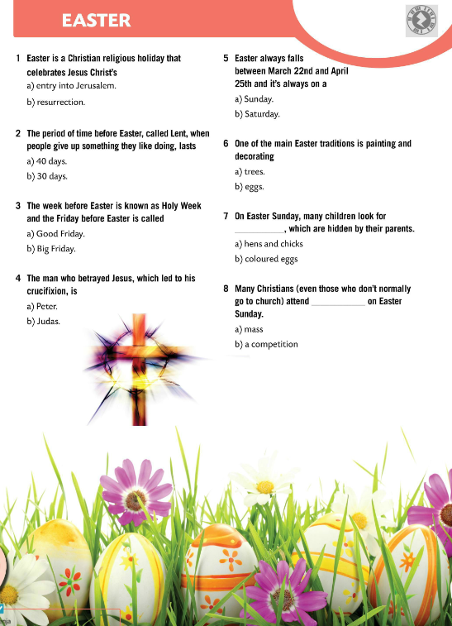
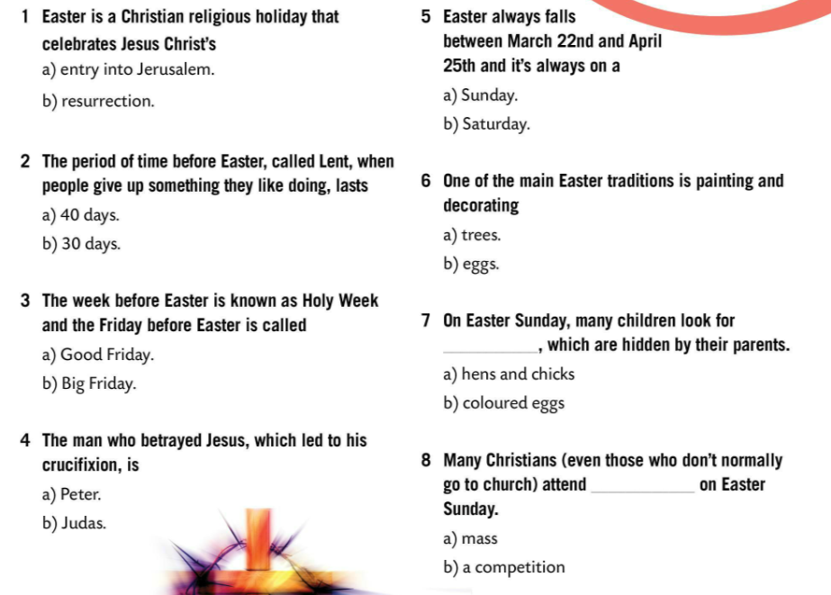
Answer the questions.
Check.
What are the symbols of Easter? Why?
Discuss in pairs. Share your opinion with the class.
Translate the following words :
resurrection
Good Friday
betray
Lent
mass

Slide 4

Watch the video and learn all about Easter in the USA and how it is celebrated.
Write down five new words and translate them into Croatian.
Is American celebration of Easter similar to yours? Why?
What tradition do you find most interesting?
Play a game.
https://wordwall.net/play/856/430/133

Slide 5

Happy Easter! ☺

